Slide 1
IOT – MQTT Masa Cirkovic

Slide 2
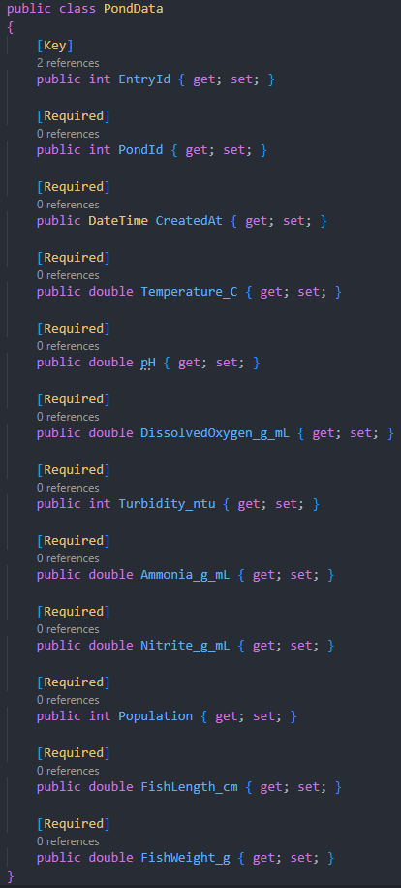
Architecture
- Sensor Microservice written in Python
Analytics Microservice written in Python
EventInfo Microservice written in .NET Core
Mosquitto MQTT is used for communication
data
Dataset is about sensor data from fishponds
It contains temperature, pH, oxygen level, etc.
Data was cleaned and pond_id was added

Slide 3
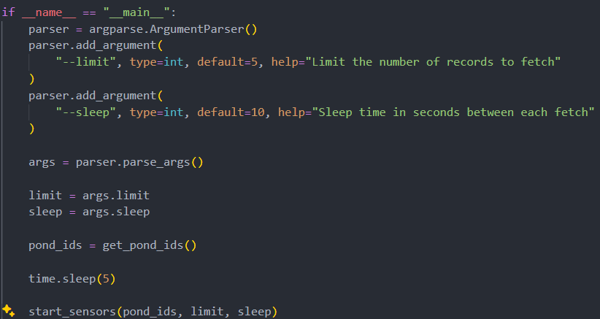
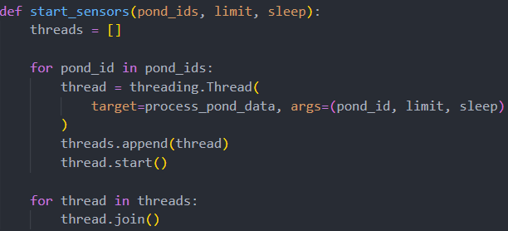
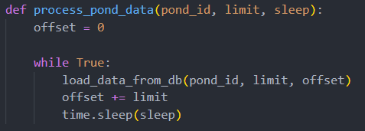
Sensor microservice

Slide 4
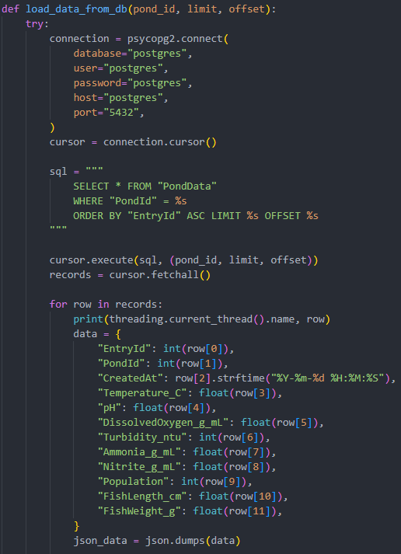
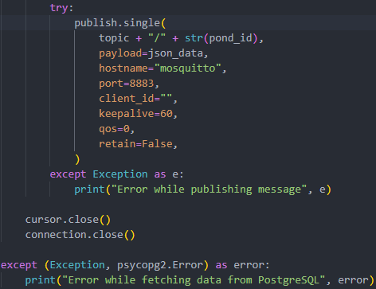
Sensor microservice

Slide 5

Sensor microservice

Slide 6

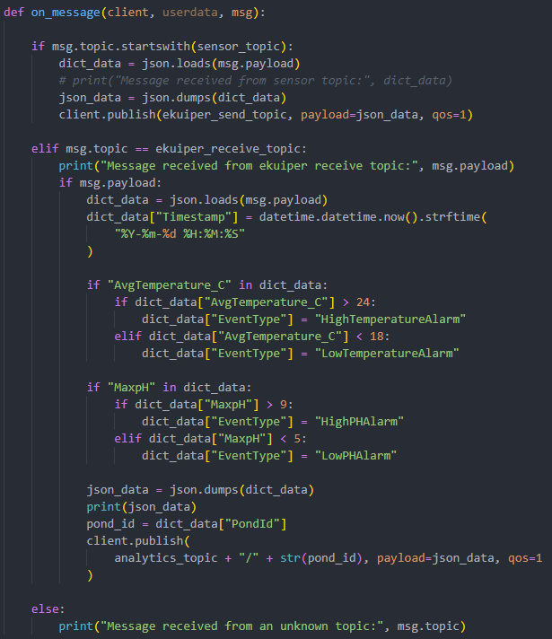
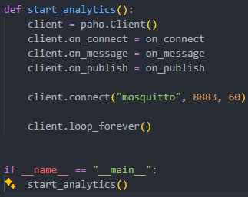


Analytics microservice

Slide 7

Analytics microservice

Slide 8
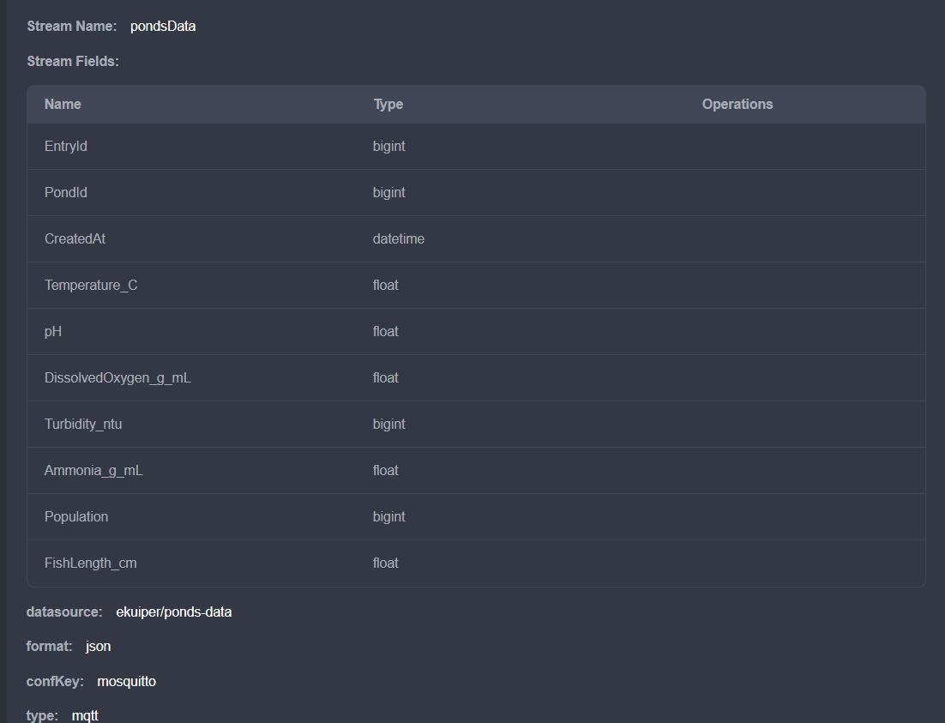
Analytics microservice

Slide 9
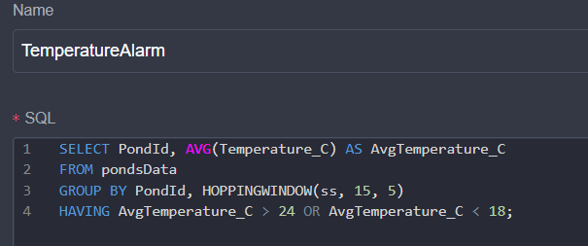
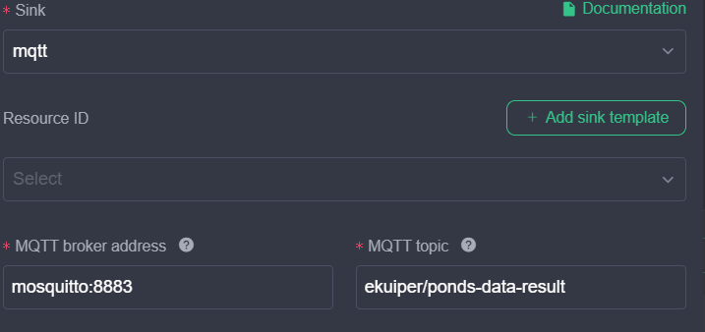
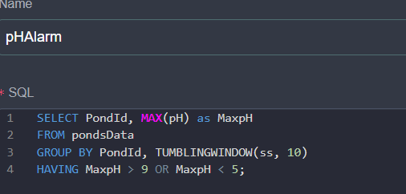
Analytics microservice

Slide 10
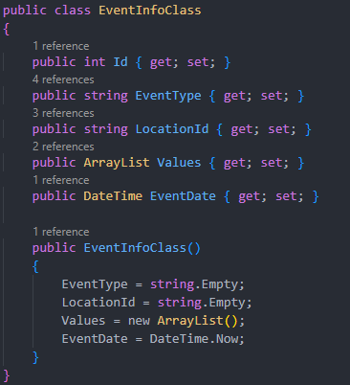
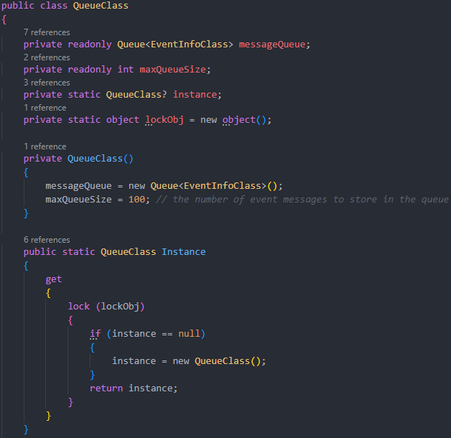
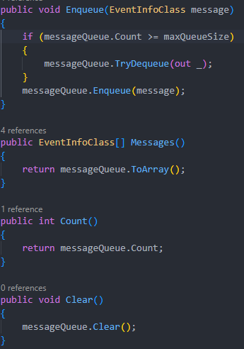
EventInfo microservice

Slide 11
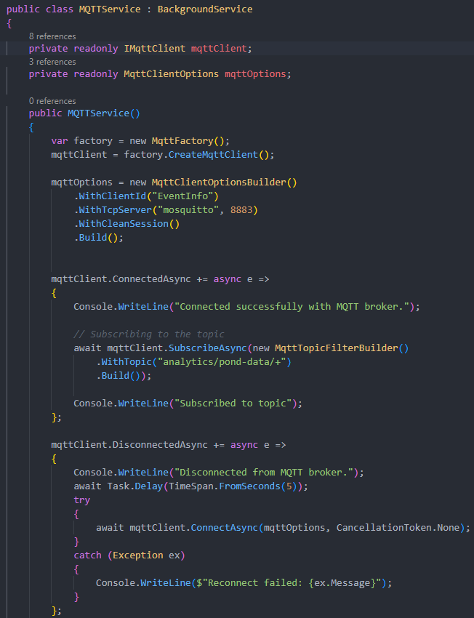
EventInfo microservice

Slide 12
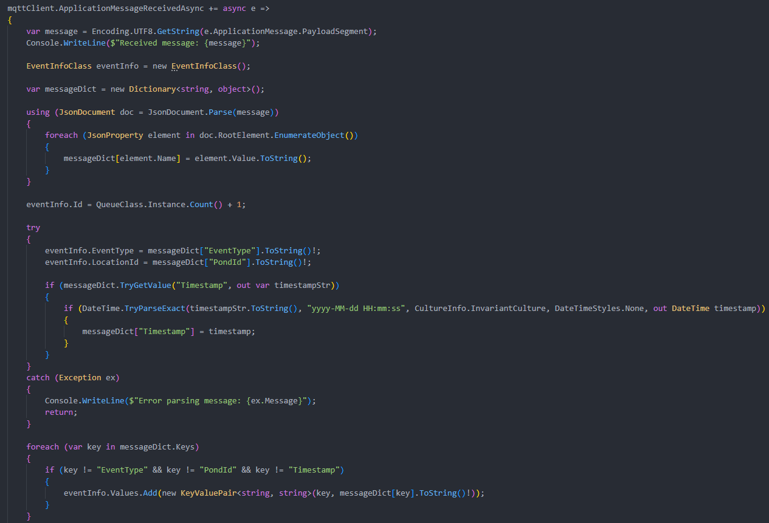

EventInfo microservice

Slide 13
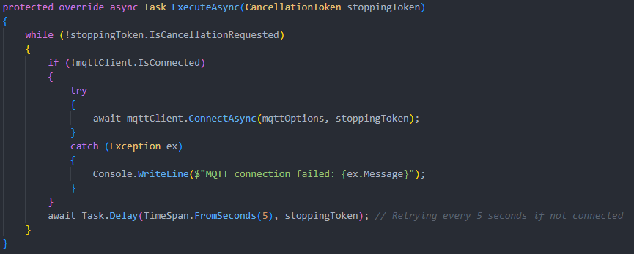
EventInfo microservice

Slide 14
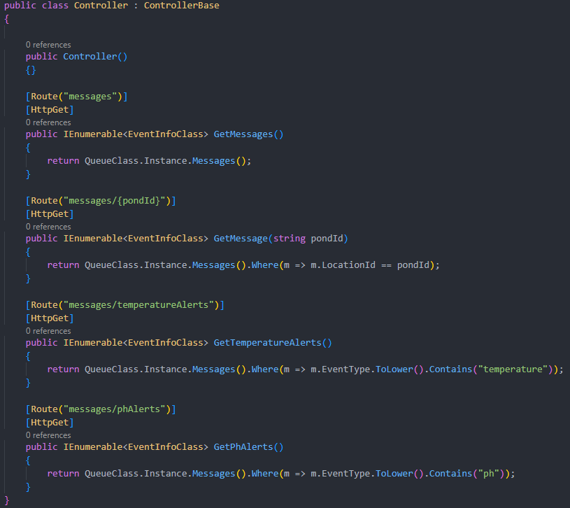
EventInfo microservice

Slide 15

EventInfo microservice

Slide 16

Config for mosquito mqtt

Slide 17
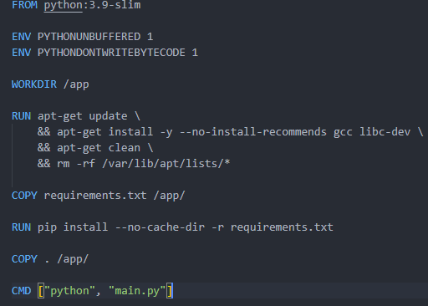
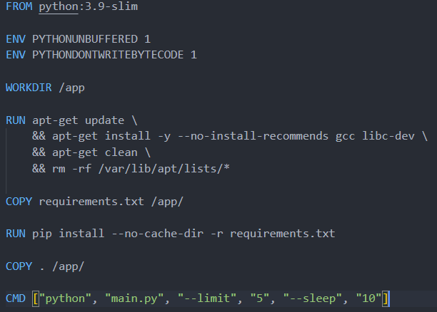
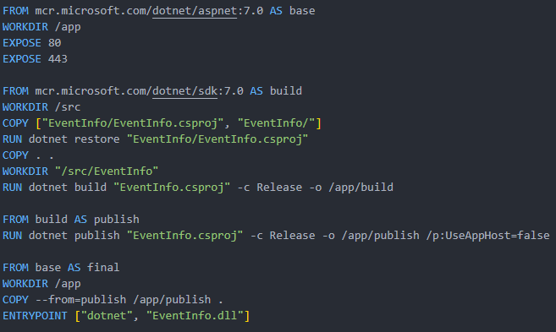
Docker files

Slide 18
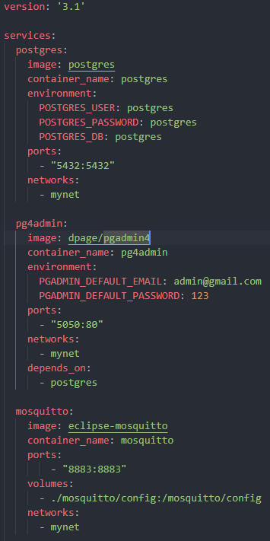
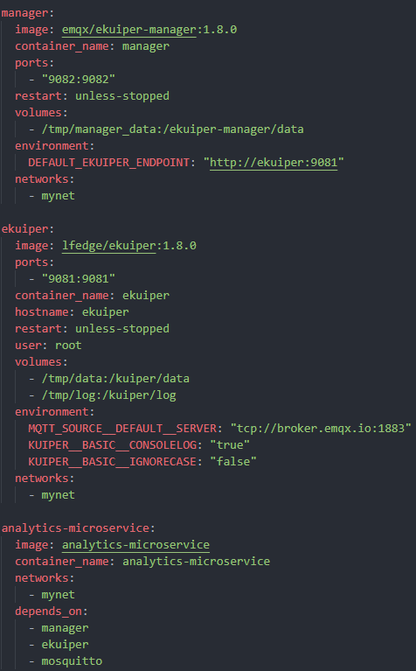
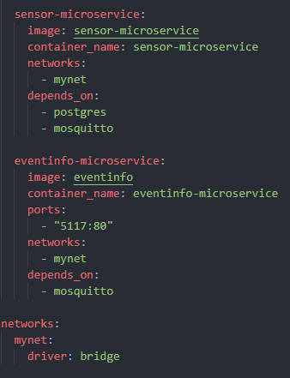
Docker compose

Slide 19
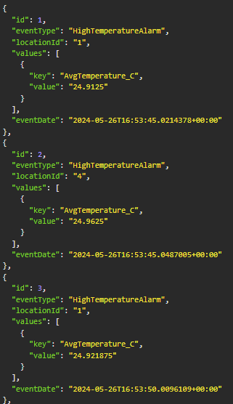
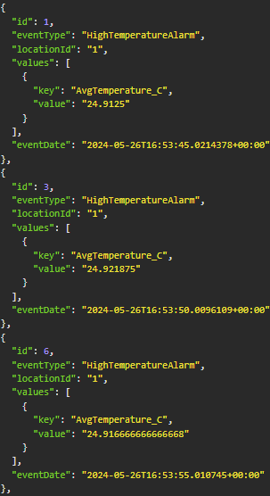
Testing
GET http://localhost:5117/messages
GET http://localhost:5117/messages/{id}

Slide 20
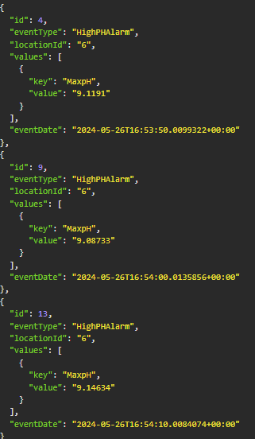
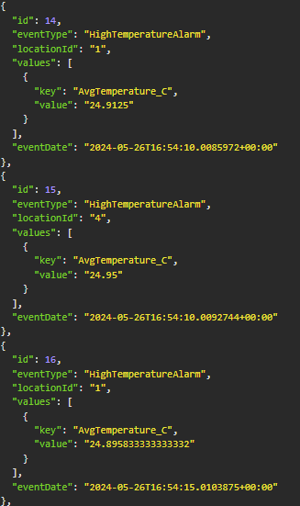
Testing
GET http://localhost:5117/messages/phAlerts
GET http://localhost:5117/messages/temperatureAlerts

